Slide 1

The Future of AI in Healthcare
Stock photos provided by Pexels
Notes:
Welcome. Today we'll explore how artificial intelligence is revolutionizing healthcare, from improving diagnostic accuracy to accelerating drug discovery. This presentation covers key findings from 2025 research and outlines the transformative potential of AI.

Slide 2

Current Challenges
Despite AI's promise, healthcare faces significant hurdles: data privacy regulations, legacy system integration, clinician adoption, dataset bias, and lengthy regulatory approvals. Overcoming these is crucial for widespread AI deployment.
Notes:
AI adoption in healthcare is not without obstacles. Data privacy under HIPAA and GDPR, integration with legacy EHR systems, and clinician trust are major barriers. Additionally, biased datasets can lead to health disparities, and regulatory approval takes an average of 18 months.

Slide 3

01
Transforming Patient Care
Notes:
Now let's dive into the key areas where AI is making an impact: diagnostics, drug discovery, and patient outcomes. These advances are backed by impressive statistics from recent research.

Slide 4
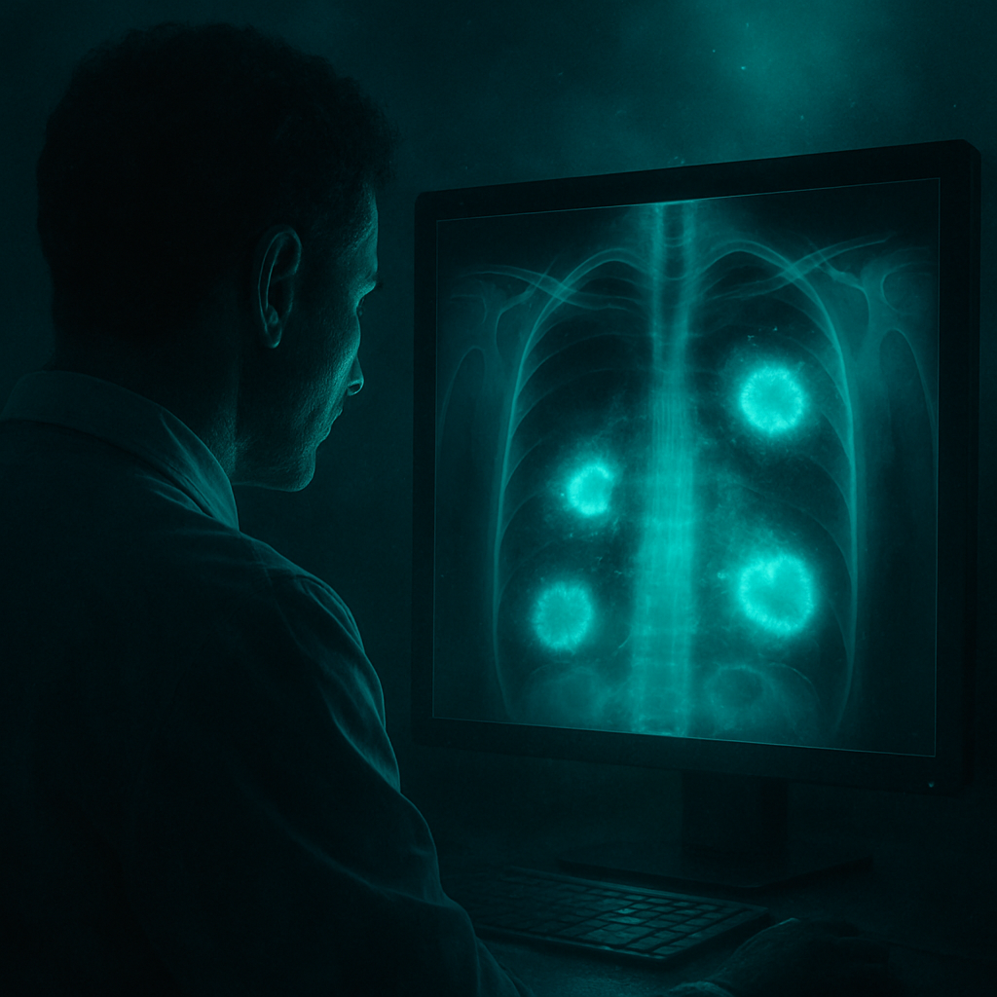
Diagnostics Revolution
AI diagnostic systems achieve 94.5% accuracy in medical imaging, surpassing human radiologists. From CT scans to ECG pattern recognition, machine learning models enhance detection rates across radiology, pathology, and cardiology.
Notes:
AI has achieved 94.5% diagnostic accuracy for medical imaging, outperforming human experts at 91.2%. Applications span radiology, pathology, cardiology, and oncology, with some models reaching 97% accuracy in tissue sample analysis.

Slide 5
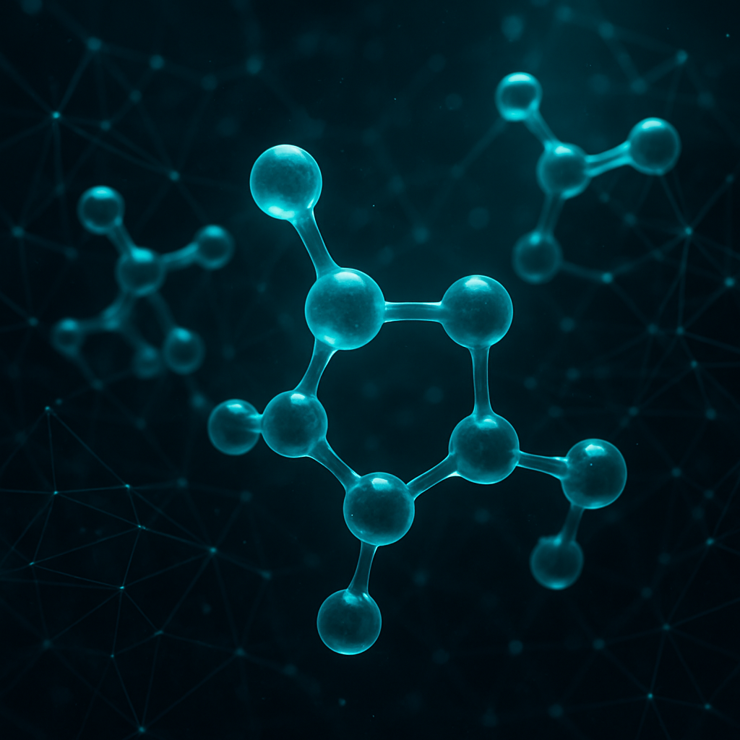
Drug Discovery Acceleration
AI accelerates drug discovery by 40%, analyzing molecular structures and predicting treatment responses. This revolution reduces development costs and brings life-saving therapies to patients faster.
Notes:
AI-assisted drug discovery has reduced time-to-market by 40%. By predicting molecular interactions and treatment responses, AI cuts costs and speeds up the journey from lab to patient, transforming the pharmaceutical industry.

Slide 6

Measurable Impact
94.5%
AI diagnostic accuracy surpasses human radiologists in medical imaging tasks
72%
Percentage of hospitals now using at least one AI system for care
40%
Reduction in drug time-to-market achieved with AI-assisted discovery
23%
Improvement in patient satisfaction scores with AI-powered triage systems
Notes:
These four metrics highlight AI's transformative impact. 72% of hospitals now use AI, and patient satisfaction has risen 23% with AI triage. The numbers speak for themselves—AI is delivering real-world results.

Slide 7

Future Growth & Potential
The global AI healthcare market is projected to reach $187.95 billion by 2030, growing at 37% CAGR. AI will continue revolutionizing radiology, pathology, cardiology, oncology, and emergency medicine.
Notes:
The market for AI in healthcare is booming, with projections of $187.95 billion by 2030 at a 37% CAGR. AI will expand across all specialties, improving efficiency and outcomes. However, challenges like integration and bias must be addressed.

Slide 8

The Road Ahead
Key Achievements
• AI diagnostic accuracy reaches 94.5%, exceeding human performance
• 72% of hospitals adopt at least one AI system
• Drug discovery time reduced by 40% through AI assistance
Future Outlook
• $187.95 billion market by 2030 at 37% CAGR
• Expanding AI applications across all medical specialties
• Overcoming regulatory and integration challenges
Explore how AI can enhance your healthcare organization's capabilities.
Notes:
In summary, AI is already delivering remarkable results in diagnostics and drug discovery, with strong adoption and market growth. The future holds even more potential. I encourage you to consider how AI can benefit your organization.

